Slide 1
Lecture 9
Approximation

Slide 2
The Approximation Problem
Training Set with real-valued inputs and outputs
Fit a model:
to minimize the loss function
by adapting the parameters
Approximation = curve-fitting / regression

Slide 3
Approximation = curve fitting using a finite data set
interpolation
extrapolation
generalization
x = available (sample)
data points
X
X
X
X
X
X
X
X
X
X
X
x

Slide 4
The Problem with Approximation
A finite number of points are given in real space
⇒ An infinite number of functions are compatible with it.
How should we choose the best?
Question to ask: Which function is most likely to be correct for unknown data?

Slide 5
Approximation = curve fitting using a finite data set
interpolation
extrapolation
generalization
x = available (sample)
data points
X
X
X
Is this a good approximation?
X
X
X
X
X
Why not?
X
X
X
x

Slide 6
Approximation = curve fitting using a finite data set
interpolation
extrapolation
generalization
x = available (sample)
data points
X
X
X
What about this one?
X
X
X
X
X
Better?
X
X
X
x

Slide 7
Approximation = curve fitting using a finite data set
interpolation
extrapolation
generalization
x = available (sample)
data points
X
X
X
And this one?
X
X
X
Probably the best!
X
X
X
X
X
x

Slide 8
The Problem with Approximation
A finite number of points are given in real space
⇒ An infinite number of functions are compatible with it.
How should we choose the best?
Question to ask: Which function is most likely to be correct for unknown data?
Answer:
“One should not increase, beyond what is necessary, the number of entities required to explain anything” William of Ockham → Occam’s Razor
“Everything should be made as simple as possible, but no simpler ”
Attributed to Albert Einstein
The simplest adequate model is likelier to be correct.

Slide 9
Why are feedforward networks approximators?
Consider a 1 hidden-layer net with n inputs and one output.
The network can be written as:
where i is the only output neuron
Assume (linear output)
Thus serve as basis functions
i.e. a weighted sum of several nonlinear functions, f_{j} , defined over the input space
Recall the sinusoidal basis

Slide 10
Let n = 1, m = 2
x
x
By adding several scaled and possibility reversed
sigmoids, we can form pretty much any
function. This remains true even if n > 1
x

Slide 11
Let n = 1, m = 2
x
x
x

Slide 12
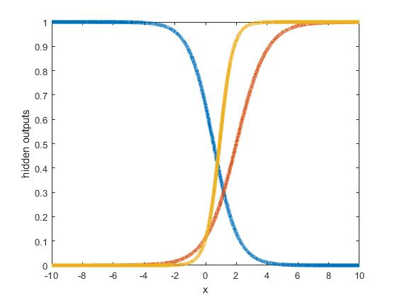
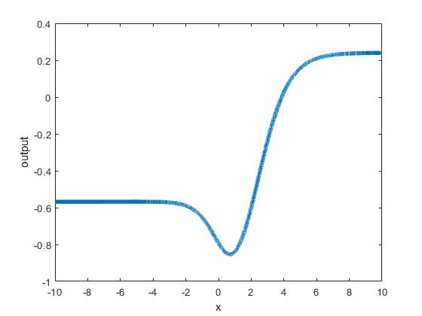
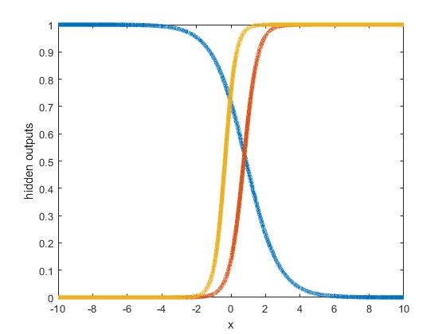
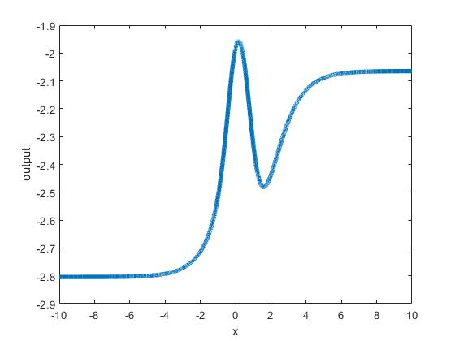
Two Real Examples with 3 Hidden Neurons

Slide 13
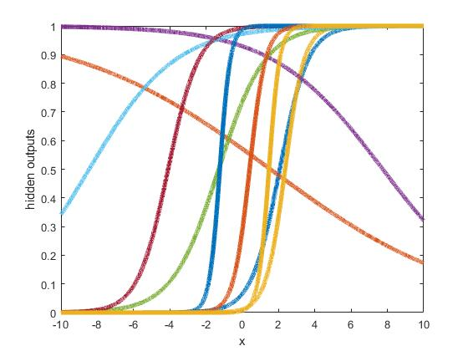
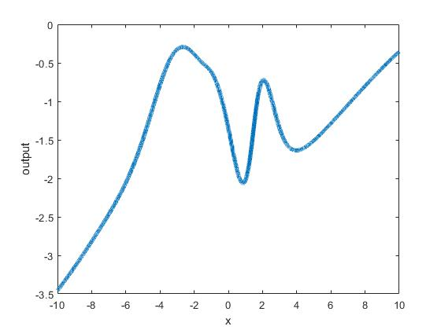
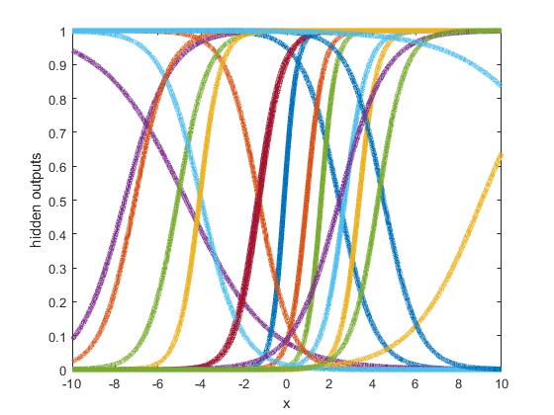
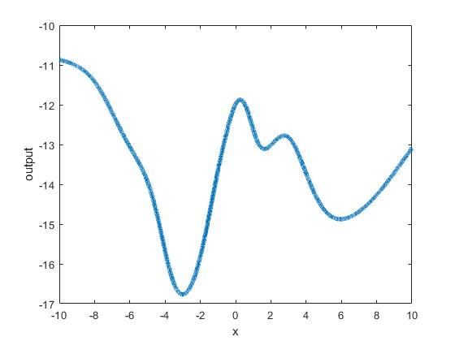
10
Hidden
20
Hidden

Slide 14
The Universal Approximation Theorem
(Cybenko; Funahashi; Hornik, Stinchcombe & White)
Let be a non-constant, bounded and monotonically increasing continuous function.
Let be the space of continuous functions on
Then, given any and
integer m and real constants
i.e. any cont. function on I_{n} can be
approximated to arbitrary precision
using one hidden layer of sigmoid
neurons
such that we can find:
and

Slide 15
Applications for Approximation
Modeling:
Given data points from an input-output system
determine
e.g.
F(heart rate, blood pressure) = autonomic nervous system function
F(externally monitored plant variables) = internal variables.
or, for a dynamical system
use data points

Slide 16
Prediction:
Given a time series x_{t}
Then use approximation to find F.
This works also when the system has external inputs
hypothesize
F
1-step
delay
Compare with a linear
autoregressive model:

Slide 17
Radial Basis Function Networks

Slide 18
Radial Basis Function (RBF) Networks
1
x₁
G₁
x₂
G₂
x_{n}
G_{m}
n-dim
(m+1)-dim
where
Gaussian
(m+1)-dim
and
linear
n-dim

Slide 19
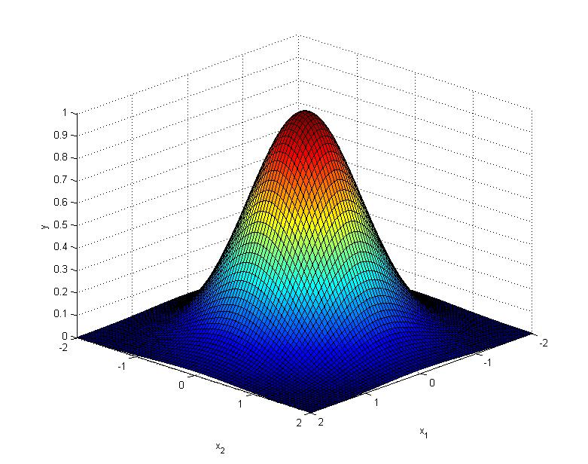
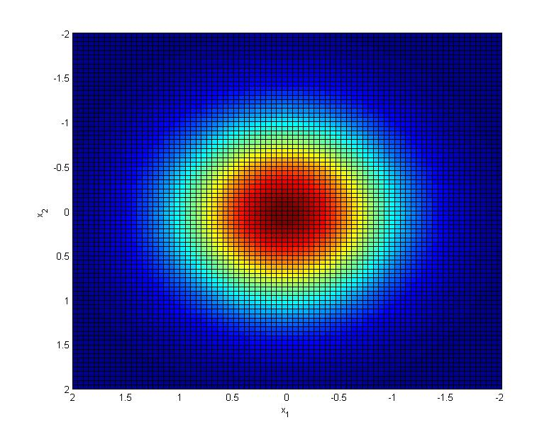
Radial Basis Functions
since is a scalar, the contours
on are circular ( equal variance)
A more general form would be to use
where Σ is a symmetric n × n matrix with non-negative diagonal values
One can use Σ⁻¹ = K^{T} K where K is any real n × n matrix – weighting matrix.
Notes:
Graph needs a little work.

Slide 20
Training RBF Networks
Option 1:
Choose fixed
Train
Now training is finding weights
for the linear estimate
using the training set
Given training set
Use LMS
(or use other linear estimation methods)
Note: σ_{j} s could be identical or different.
define

Slide 21
Option 2:
Adapt centers through self-organization
Fix
Obtain H using the
Train using LMS etc.
Option 3:
Treat as
parameters in an optimization
problem and train them all by
gradient descent or some other
method.
Full Supervised Learning
we’ll do this later
Notes: a) ‘s can be obtained by
k-means clustering or some
other clustering method
b) can be identical for each
j or chosen heuristically

